Slide 1
Computer Organisation
Topic 1
Introduction
(Part 1)
Stallings, Computer Organization & Architecture (9th Ed.), Chap. 1

Slide 2
Outline
History of computers
X86, PowerPC and ARM evolution
Organisation and architecture
Structure and function
Computer evolution and performance
Cloud Computing
Performance Issues

Slide 3
Architecture & Organisation
Architecture is those attributes visible to the programmer (programmer’s view of a computer)
It is defined by the instruction set
(language), and operand locations (registers and memory).
Deals with the functional behaviour of a computer system
Attributes: a system that has a direct impact on the logical execution of a program
It defines the system in an abstract manner
It deals with What does the system do
Instruction set, number of bits used for data representation, I/O mechanisms, addressing techniques
e.g. Is there a multiply instruction?
Notes:
The first step in understanding computer architecture is learning its language.
The words in a computer’s language are called instructions. The computer’s vocabulary is called the instruction set.
All programs running on a computer use the same instruction set.
Even complex software applications, such as word processing and spreadsheet applications, are eventually compiled into a series of simple instructions such as add, subtract, and jump.
Computer instructions indicate both the operation to perform and the operands to use. The operands may come from memory, from registers, or from the instruction itself.

Slide 4
Architecture & Organisation
Organization is how features are implemented
Deals with structural relationship
Attributes: hardware details transparent to the programmer
Is the way in which a system must structure and It is operational units and the interconnections between them that achieve the architectural specifications
It is the realization of the abstract model
It deals with How to implement the system
Control signals, interfaces between the computer and peripherals, memory technology
e.g. Is there a hardware multiply unit or is it done by repeated addition?

Slide 5
Architecture & Organisation
Computer architecture is about "what" a computer system does, while computer organization is about "how" it does it. Architecture defines the capabilities and features, while organization determines how those features are implemented in hardware.
A systematic approach of deriving the solution of any problem
Manufacturers produce family of computer models
Same architecture, different organisation
Different models = different price and performance

Slide 6
Architecture & Organisation
All Intel x86 family share the same basic architecture
Similarly ARM Cortex-M, R and A families have the same respective ARMv7-M, R and A architectures
Notes:
X86
The world's predominant hardware platform for laptops, desktops and servers.
The x86 line was developed by Intel and includes the Core, Xeon, Pentium, Atom and original 8086 family (hence the "86"). With an even greater market share than x86
ARM is the hardware platform for mobile devices and appliances
ARM cortex
ARM Cortex-M architecture highly efficient, low cost and energy-efficient processor and it has been used in millions of customer devices.
Application of cortex-M4 mainly lies in the areas where we need intense digital signal processing or we want to do math related operating in floating point format.

Slide 7
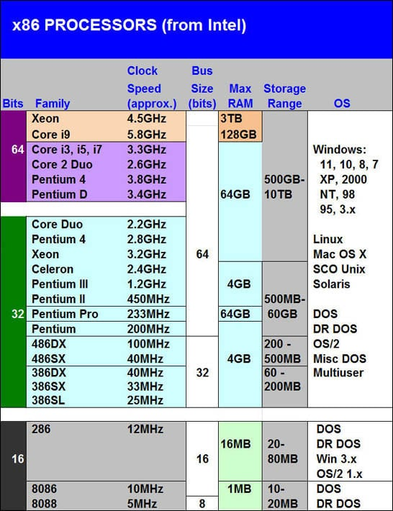
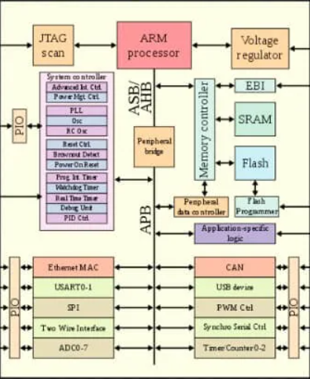
Architecture & Organisation
Family concept allows code compatibility
At least backwards
Because same architecture, but organisation differs between different versions
Customer’s software investment protected
Notes:
A prominent example of both these phenomena is the IBM System/370 architecture.
This architecture was first introduced in 1970 and included a number of models.
Customers with modest requirements could buy a cheaper, slower model and, if demand increases, later upgrade to a more expensive, faster model without abandoning software that has already been developed.
Over the years, IBM has introduced many new models with improved technology to replace older models, offering the customer greater speed, lower cost, or both.
These newer models retained the same architecture to protect the customer’s software investment.

Slide 8
Outline
History of computers
X86, PowerPC and ARM evolution
Organisation and architecture
Structure and function
Computer evolution and performance
Cloud Computing
Performance Issues

Slide 9
Structure & Function
A computer is a complex system
A hierarchical system is a set of interrelated subsystems
At each level, look into the components and their interrelationships
Notes:
9
A computer is complex; contemporary computers contain millions of elementary electronic components.
How, then, can one clearly describe them? The key is to recognize the hierarchical nature of most complex systems
A hierarchical system is a set of interrelated subsystems; each subsystem may, in turn, contain lower-level subsystems, until we reach the lowest level of elementary subsystem

Slide 10
Structure & Function
Structure is the way in which components relate to each other
Function is the operation of the individual component as part of the structure
Notes:
10

Slide 11
Structure & Function
In terms of description, we have two choices:
Bottom-up
Top-down
Starting at the bottom and building up to a complete description
Beginning with a top view and decomposing the system into its subparts
Notes:
11

Slide 12
Structure & Function
Clearer to describe computer system using top-down approach
start with major components (their structure & function)
proceed to the lower layer

Slide 13
Function
All computer functions are:
Data processing
Data storage
Data movement
Control
Notes:
Both the structure and functioning of a computer are, in essence, simple.
In general terms, there are only four basic functions that a computer can perform

Slide 14
Function
All computer functions are:
Data processing
Data storage
Data movement
Control
Data may take a wide variety of forms and different processing requirements
Even though the computer process the data on the fly, the computer must temporarily store at least those pieces of data
Short term vs long term data storage
Input-output (I/O) Peripheral
Manages the computer resources
Notes:
Data processing: Data may take a wide variety of forms, and the range of processing requirements is broad. However, we shall see that there are only a few fundamental methods or types of data processing.
Data storage: Even if the computer is processing data on the fly (i.e., data come in and get processed, and the results go out immediately), the computer must temporarily store at least those pieces of data that are being worked on at any given moment. Thus, there is at least a short-term data storage function. Equally important, the computer performs a long-term data storage function. Files of data are stored on the computer for subsequent retrieval and update.
Data movement: The computer’s operating environment consists of devices that serve as either sources or destinations of data. When data are received from or delivered to a device that is directly connected to the computer, the process is known as input–output (I/O), and the device is referred to as a peripheral. When data are moved over longer distances, to or from a remote device, the process is known as data communications.
Control: Within the computer, a control unit manages the computer’s resources and orchestrates the performance of its functional parts in response to instructions.

Slide 15
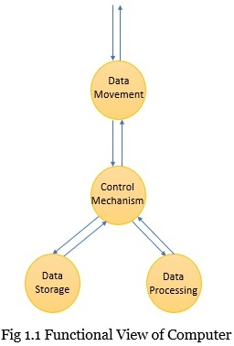
Functional View

Slide 16
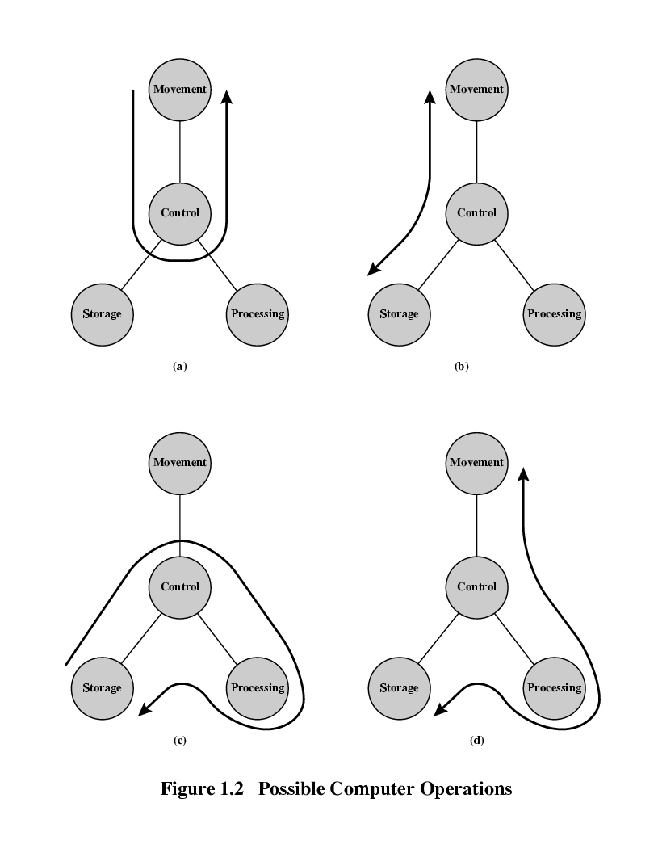
Operations (a) Data movement
Notes:
Every computer has an input and output device that makes the computer move data between itself and outside the world
The input devices are meant for entering the data into the computer. It is the data that we need to process. The output devices are where the computer displays the produced result or the output data.

Slide 17
Operations (b) Storage
Notes:
Once the processing has been done there must be some means to store the final and intermediate results.
Even though it seems that we enter the data into the computer, it processes that data and immediately produces the result.
But still, the computer needs to store those pieces of data that are being worked on at the current moment.

Slide 18
Operation (c) Processing from/to storage
Notes:
If we talk of the computer, basically we consider it for performing computation. So, there must be a unit in the computer that would perform computation.
For performing computation this unit must be capable of processing data.
It is the data processing unit that processes the data.
It must also be able to process data in a wide variety of forms.

Slide 19
Operation (d) Processing from storage to I/O
Notes:
The computers are also capable of moving data over a longer distance i.e., to or from a remote device.
We refer to this moving of data between the remote devices as data communication.

Slide 20
Control a unit that would control and synchronize the function of these units
Notes:
However, controlling of these three units is regulated by the individual who provides the instruction to the computer. In response to these instructions the control unit manages the resources of the computer and controls the performance of the functional units.

Slide 21
Function
?
Data processing
Data storage
Data movement
Control
Which is the most important?

Slide 22
Function
?
Data processing
Data storage
Data movement
Control
Which is the “busiest”?

Slide 23
Function
Data processing
Data storage
Data movement
Control
So, which is the most important? ☺

Slide 24
Structure
Internal structure of a computer:
4 main components
Central processing unit (or processor)
controls the operation and performs data processing
Main memory
stores data
I/O
moves data between the computer and its external environment
System interconnection
mechanism for communication among CPU, main memory and I/O
Notes:
We begin with a traditional computer with a single processor that employs a microprogrammed control unit, then examine a typical multicore structure.

Slide 25
Structure Top Level
Peripherals
Computer
Central
Processing
Unit
Main
Memory
Computer
Systems
Interconnection
Input
Output
Communication
lines
Notes:
Central processing unit (CPU): Controls the operation of the computer and performs its data processing functions; often simply referred to as processor.
Main memory: Stores data.
I/O: Moves data between the computer and its external environment.
System interconnection: Some mechanism that provides for communication among CPU, main memory, and I/O.

Slide 26
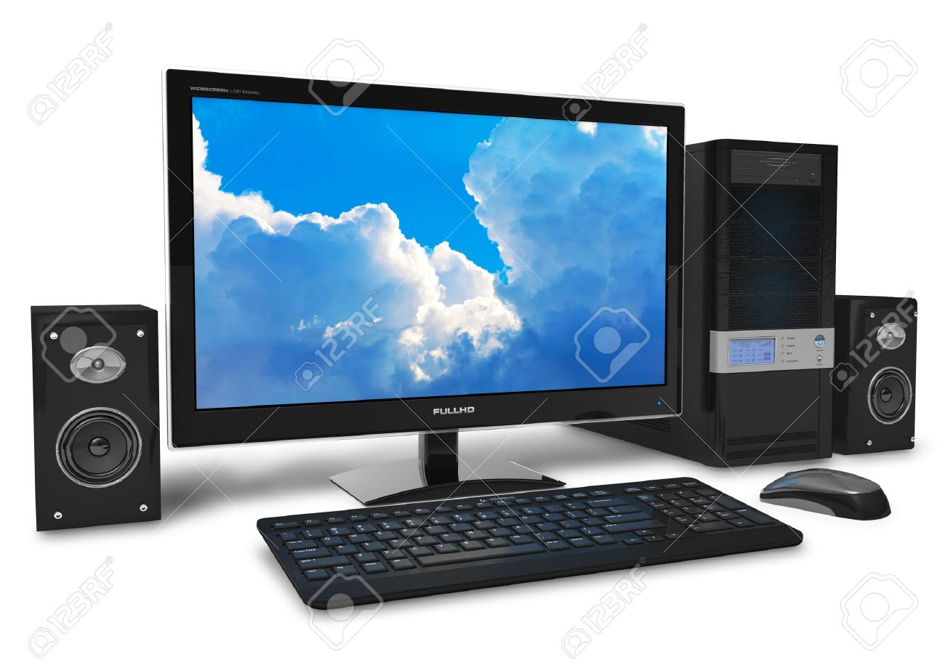
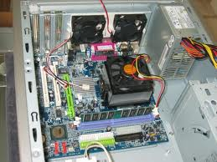
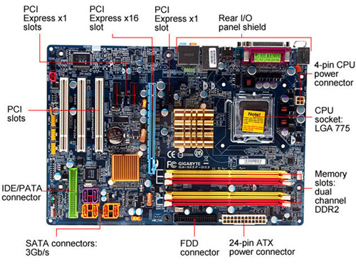
Structure Top Level (Hardware)
Source: https://www.123rf.com/photo_9645973_black-stylish-desktop-pc-isolated-on-white-background.html
Source: https://www.legitreviews.com/gigabyte-ga-965p-ds3-motherboard-review_418

Slide 27
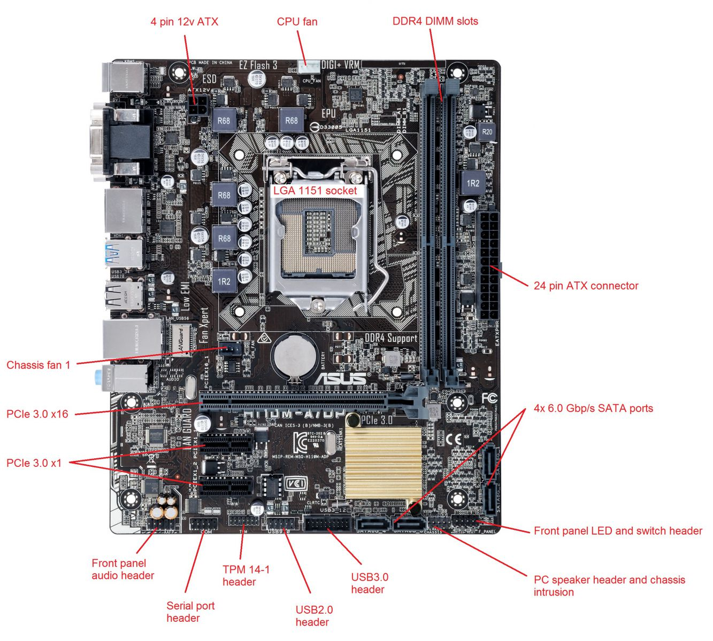
Structure Top Level (Hardware)
Asus H110M-A
Source: https://kb.stonegroup.co.uk/ index.php?CategoryID=7#f543

Slide 28
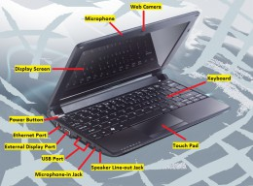
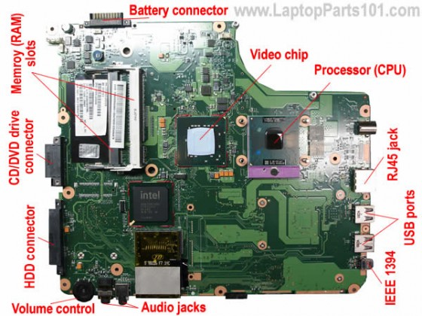
Structure Top Level (Hardware)

Slide 29
Structure Top Level
Peripherals
Computer
Central
Processing
Unit
Main
Memory
Computer
Systems
Interconnection
Input
Output
Communication
lines

Slide 30
Structure The CPU
CPU
Computer
Arithmetic
and
Logic Unit
I/O
Registers
System
Bus
CPU
Internal CPU
Interconnection
Memory
Control
Unit

Slide 31
Structure The Control Unit
Control Unit
CPU
Sequencing
Logic
ALU
Internal
Bus
Control
Unit
Control Unit
Registers and
Decoders
Registers
Control
Memory

Slide 32

Structure
Computer
Central processing unit (or CPU or processor)
Main memory
I/O
System interconnection
TOP
DOWN
Central processing unit
Arithmetic and logic unit (or ALU)
Registers
Control unit
Internal CPU interconnection
What can you notice?

Slide 33
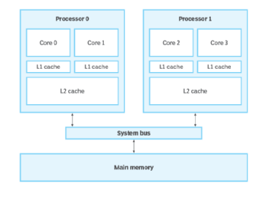
Multicore Computer Structure
Contemporary computers generally have multiple processors
When these processors all reside on a single chip, the term multicore computer is used, and each processing unit (consisting of a control unit, ALU, registers, and perhaps cache) is called a core

Slide 34
Multicore Computer Structure
Terminology
Central processing unit (CPU)
Fetches and executes instructions
Consists of an ALU, a control unit, and registers
Referred to as a processor in a system with a single processing unit
Core
An individual processing unit on a processor chip
May be equivalent in functionality to a CPU on a single-CPU system
Specialized processing units are also referred to as cores

Slide 35
Multicore Computer Structure
Terminology
Processor
Containing one or more cores
Interprets and executes instructions
Referred to as a multicore processor if it contains multiple cores

Slide 36
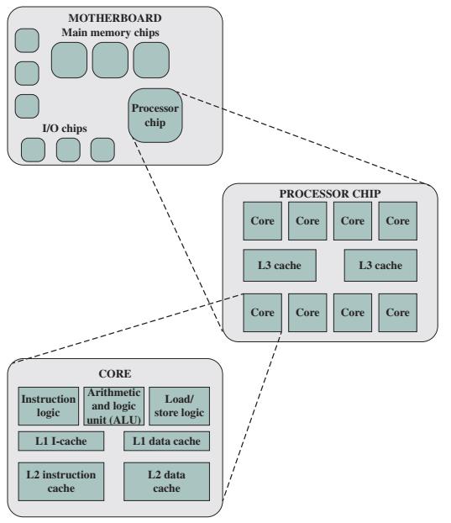
Multicore Computer Structure

Slide 37

Reflection…
From the lecture today,
I learnt…
Link on eLearn / Chat
Image source: https://www.flickr.com/photos/29143375@N05/4582236533

